Slide 1
Iterator Pattern
SDA (C&D)

Slide 2
Iterator Pattern
Iterator Pattern is a relatively simple and frequently used design pattern. There are a lot of data structures/collections available in every language. Each collection must provide an iterator that lets it iterate through its objects. However while doing so it should make sure that it does not expose its implementation.

Slide 3
Suppose we are building an application that requires us to maintain a list of notifications. Eventually, some part of your code will require to iterate over all notifications. If we implemented your collection of notifications as array you would iterate over them as:

Slide 4
// If a simple array is used to store notifications for
(int i = 0; i < notificationList.length; i++) Notification notification = notificationList[i]);

Slide 5
// If ArrayList is Java is used, then we would iterate // over them as: for (int i = 0; i < notificationList.size(); i++) Notification notification = (Notification)notificationList.get(i);

Slide 6
And if it were some other collection like set, tree etc. way of iterating would change slightly. Now, what if we build an iterator that provides a generic way of iterating over a collection independent of its type.

Slide 7
// Create an iterator
Iterator iterator = notificationList.createIterator(); // It wouldn’t matter if list is Array or ArrayList or // anything else.
while (iterator.hasNext())
{
Notification notification = iterator.next());
}

Slide 8
Iterator pattern lets us do just that. Formally it is defined as below: The iterator pattern provides a way to access the elements of an aggregate object without exposing its underlying representation.

Slide 9
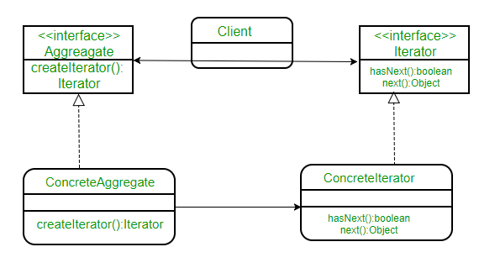

Slide 10
The ConcreteAggregate implements createIterator() that returns iterator for its collection. Each ConcreteAggregate’s responsibility is to instantiate a ConcreteIterator that can iterate over its collection of objects. The iterator interface provides a set of methods for traversing or modifying the collection that is in addition to next()/hasNext() it can also provide functions for search, remove etc.

Slide 11
Let’s understand this through an example. Suppose we are creating a notification bar in our application that displays all the notifications which are held in a notification collection. NotificationCollection provides an iterator to iterate over its elements without exposing how it has implemented the collection (array in this case) to the Client (NotificationBar).

Slide 12
